Slide 1
Moving from a Monolithic Architecture to a Microservices Architecture
Twiga Foods

Slide 2
Background

Slide 3
Social Media Handles
@TwigaFoods
@thatmarc_
@MshindiVic

Slide 4
What is Twiga Foods?

Slide 5
Twiga Foods
Twiga Foods is a Kenyan B2B business that sources quality produce from farmers, and delivers it to vendors in Urban areas using a mobile-based, cashless supply platform to access distribution into the millions of small and medium-sized vendors in urban markets. We offer better prices to farmers and vendors while providing quality produce.

Slide 6
Twiga Tech
Twiga tech is the team that works on supporting all business processes with technology.

Slide 7
The Problem
We had a monolithic architecture that did not allow the team to scale fast enough to meet the business needs in the Twiga context.

Slide 8
What is a Monolith?

Slide 9
Monolith
A monolith is an application where everything is bundled as one, has a single code base with multiple modules and is designed to be self-contained.
Modules are interconnected and interdependent in a very tightly coupled architecture.

Slide 10
Disadvantages
Increased risk per commit
Teams and developers experienced less freedom, flexibility & decreased velocity.
Inefficient use of resources
Harder to maintain our codebase
The system was not stack or language agnostic
All modules use one database
Increased risk of system failure

Slide 11
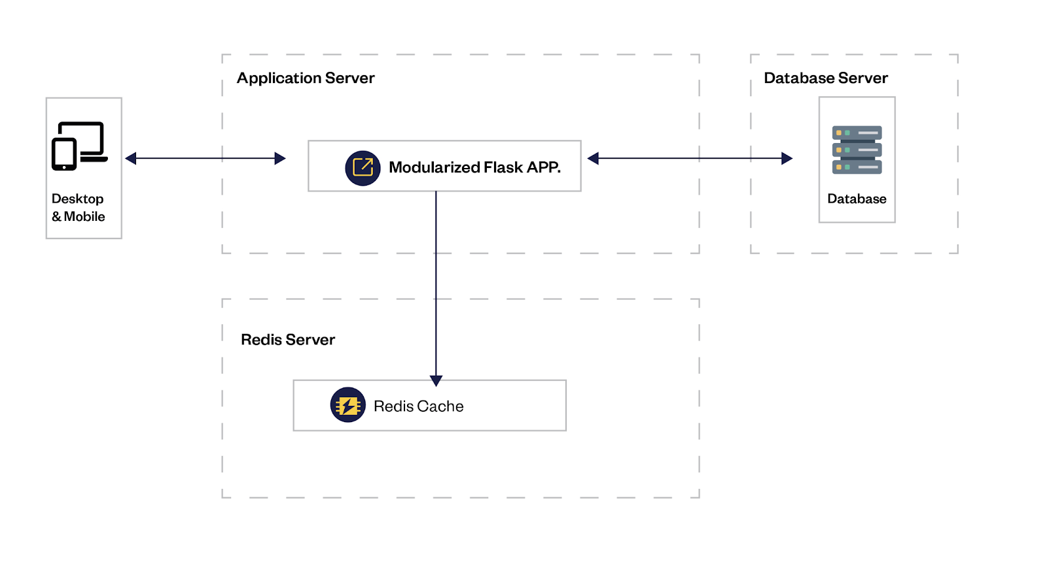

Slide 12
The Question
What approach should we take when redesigning our architecture?

Slide 13
What are Microservices?

Slide 14
Microservice
“Small autonomous services that work together, modeled around a business domain.” — Sam Newman

Slide 15
Microservice
It is a modular approach to software architecture that seeks to build services that are independent and loosely coupled.
While optimizing around the autonomy of teams, increasing developer & team freedom, decentralizing power and creating a sense of ownership.’’’

Slide 16
Breaking down the monolith functions into microservices

Slide 17
Domain Driven Design
It is a methodology that discourages teams from focusing primarily on the technology but instead, it encourages teams to look at the business activities that they seek to simplify using technology and then design around that.

Slide 18
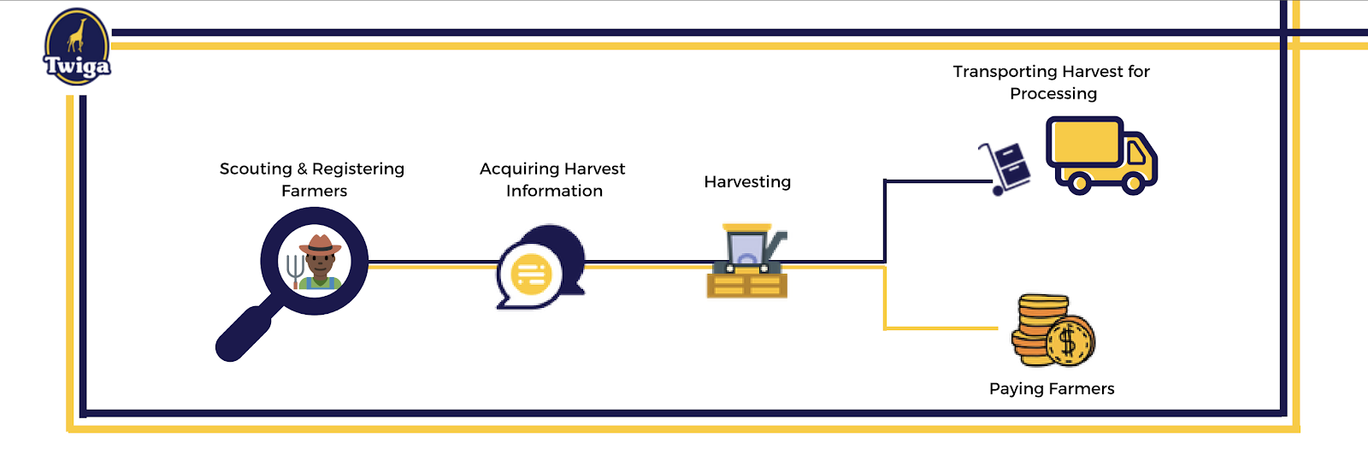
Sourcing Domain
Twiga sources for produce from farmers which is then transported to a different location for processing.

Slide 19
Technology & Infrastructure
We needed to rearchitect our infrastructure and move to one that is resilient, persistent and can easily scale.
In addition we needed to figure what technology to use to build our first cohort of microservices.

Slide 20
Framework
- We needed a framework that was simple, bare-bones and with out of the box features suited for the architecture.

Slide 21
Nameko
- It is an extensible framework that is compatible with almost any protocol, transport or database and helps one focus on business logic by managing connections, transports, and concurrency for you.
- Provides easy concurrency by yielding workers as they wait for I/O
- RPC out of the box

Slide 22
Infrastructure
To be specific the infrastructure needed to;
- Automate deployments and abstract a lot of infrastructure technicalities from developers;
- Provider each microservice with isolation;
- Handle authentication for all micro-services;
- Provide a single entry point to access all microservices;
- Handle load and effortlessly scale applications;
- Ensure code quality and high tests coverage;
- Optimize developer velocity.

Slide 23
Tools
- Kong
- GraphQL
- Bitbucket
- Docker
- Kubernetes

Slide 24
Bitbucket
We needed to ensure that despite team growth, high code quality would be maintained and that new code would not break anything but at the same time offer a smooth and efficient process that would not negatively impact developer velocity.

Slide 25
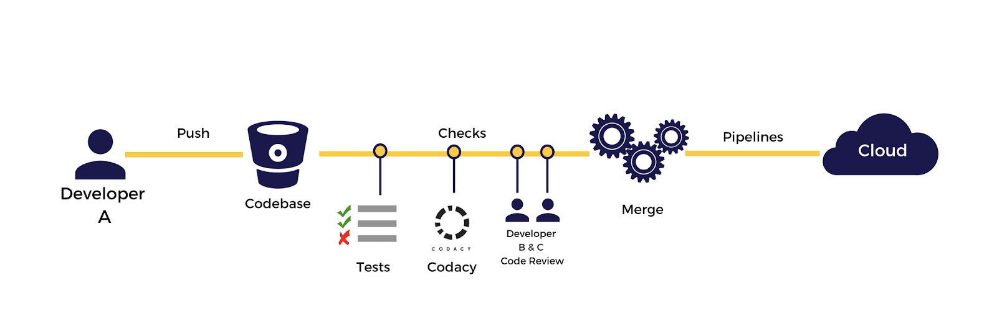

Slide 26
Kong
- An API gateway built on top of NGINX, like middleware between computing clients and API-based applications.
- Reverse proxy that processes our client requests
- Is made up of a server and a data store
- Has plugins such as authentication, security, traffic control, logging, analytics and monitoring.

Slide 27
What is GraphQL?

Slide 28
GraphQL
“is a query language for your API, and a server-side runtime for executing queries by using a type system you define for your data. GraphQL isn’t tied to any specific database or storage engine and is instead backed by your existing code and data.” (Source — graphql.org)

Slide 29
GraphQL
-Attempts Marry the best of SOAP and REST
- Reduces Roundtrips
- Easily evolve our API
- Schema stitching

Slide 30
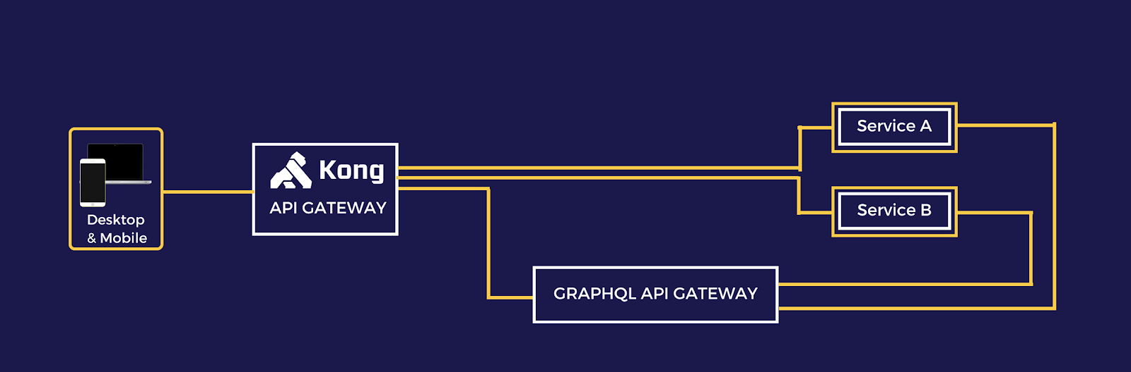

Slide 31
Docker
- Docker provides a way to run applications securely & isolated in a container, packaged with all its libraries and dependencies, ensuring that your application works seamlessly in any environment.
- Offer abstraction by which an application can quickly move or be set up with minimal interaction and tinkering.

Slide 32
Kubernetes
- Used to orchestrate, deploy and manage container clusters, which are a group of containers.
- Handles load balancing
- Self heals
- Horizontally scale

Slide 33
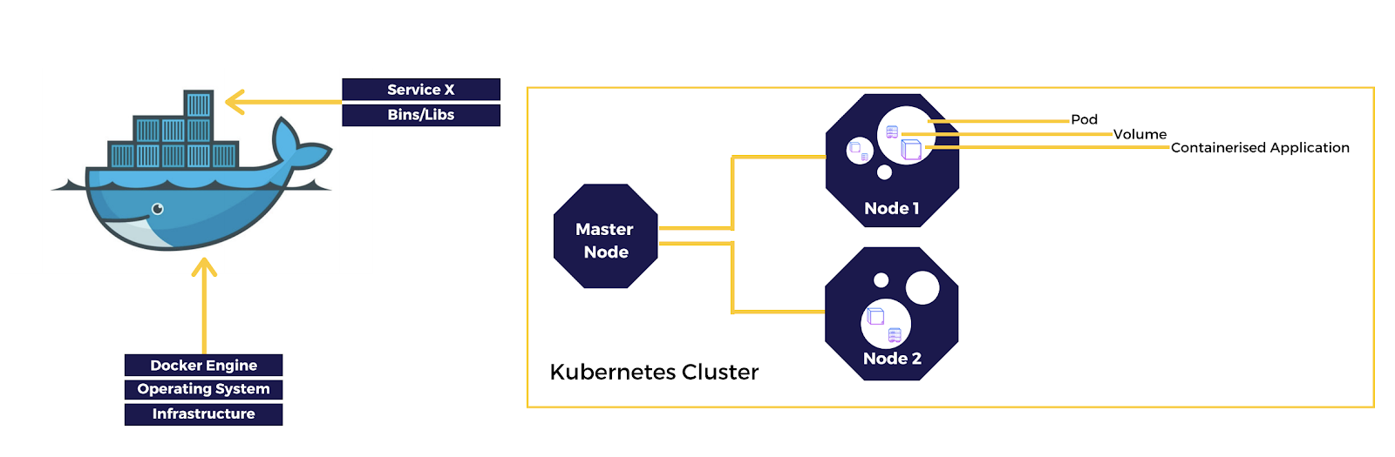

Slide 34
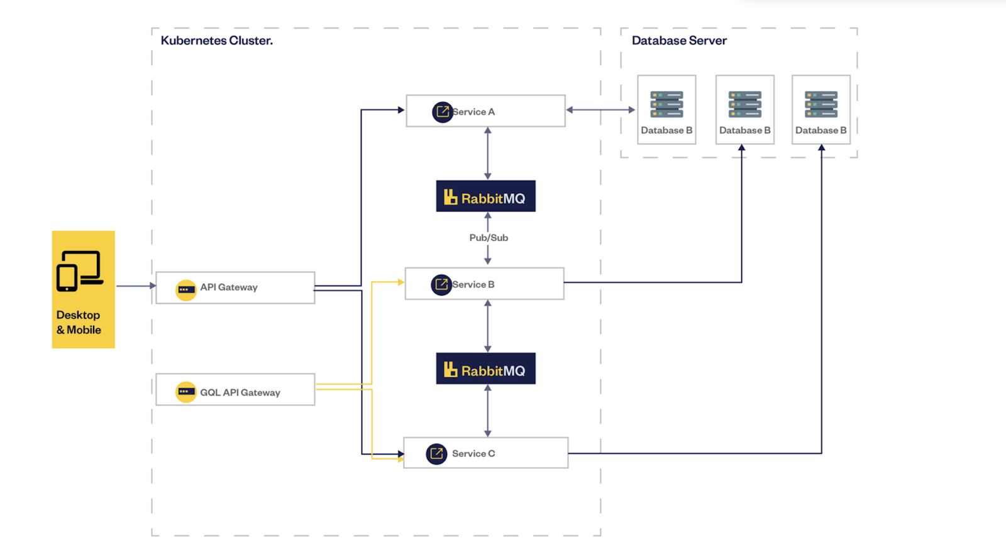

Slide 35
Advantages?

Slide 36
Advantages
- Resilience
- DevOps
- Technology flexibility
- Easier to enhance
- Developer freedom and increased velocity
- Reduced Cost and scalability
- Easier on boarding

Slide 37
Why you should not to use Microservices?

Slide 38
Why you should not to use Microservices
- You’re starting out
- You don’t have a large team
- Microservices can be distributed monoliths
- Complex service to service relationships
- Too small to break
- Extremely dependant modules
- There is beauty in simplicity

Slide 39
Code Session

Slide 40
Questions and Answers

Slide 41
Thank you :)

